Slide 1
W04 – Setting up spark environment
Lab01 practice
2024
The Hoang

Slide 2
Learning Objectives – w04 & W05
Lab 00: Setting Up PySpark with Jupyter Notebook
Lab 01: Introduction to SparkContext and RDDs
Lab 02: Introduction to SparkSession and DataFrames APIs
Lab 03: SparkSQL and DataFrames Integration
Lab 04: Advanced RDDs and Pair RDDs
Lab 05: DataFrames vs RDDs: Performance and Use Cases
Notes and Recommendations

Slide 3
Lab 00
Setting Up PySpark with Jupyter Notebook
2024
The Hoang

Slide 4
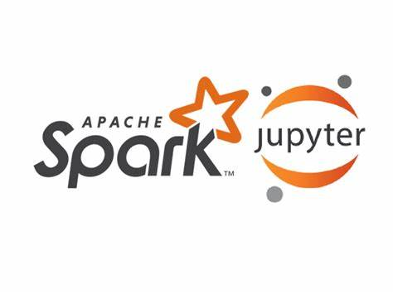
Setup Spark environment
Objective
Setup Jupyter Notebooks with Apache Spark
Prerequisites
If you are using Windows OS, setup WSL2 for Windows PC. Follow this instruction or this official link from Microsoft.
Setup Docker Desktop
Link Download and Setup Docker Desktop for Windows PCs
Link Download and Setup Docker Desktop for MacOS / Linux
[Optional] Install Docker Toolbox for PCs which don’t support Docker Desktop

Slide 5
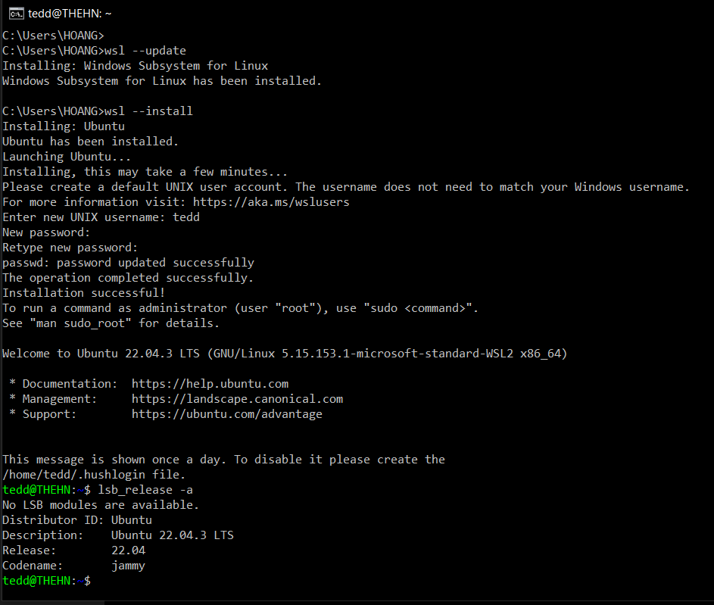
[Windows] Setup & verify WSL
Check if the WSL is installed
wsl --list –verbose
List all the online distributions
wsl –-list –-online
Set default version to 2
wsl –-set-default-version 2
Install Ubuntu
wsl --update
Check if the WSL is installed
wsl --install

Slide 6
[Windows] Setup & verify WSL
The WSL --install command performs the following actions:
Enables the optional WSL and Virtual Machine Platform components
Downloads and installs the latest Linux kernel
Sets WSL 2 as the default
Downloads and installs the Ubuntu Linux distribution (reboot may be required)

Slide 7
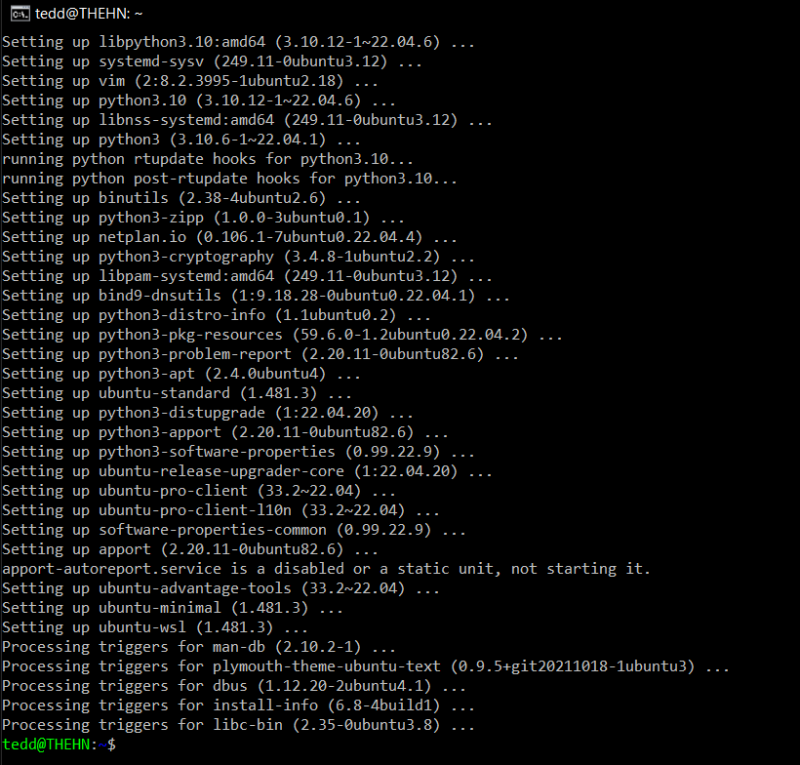
[Windows] Setup & verify WSL
Update and upgrade packages
sudo apt update && sudo apt upgrade

Slide 8
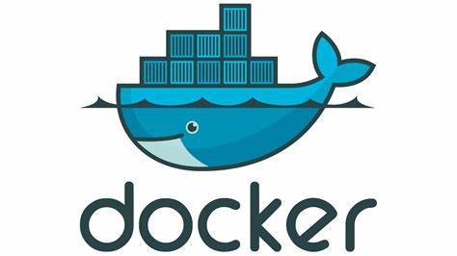
Setup Docker
Docker
An open-source platform that enables the development, deployment, and management of applications using containers

Slide 9
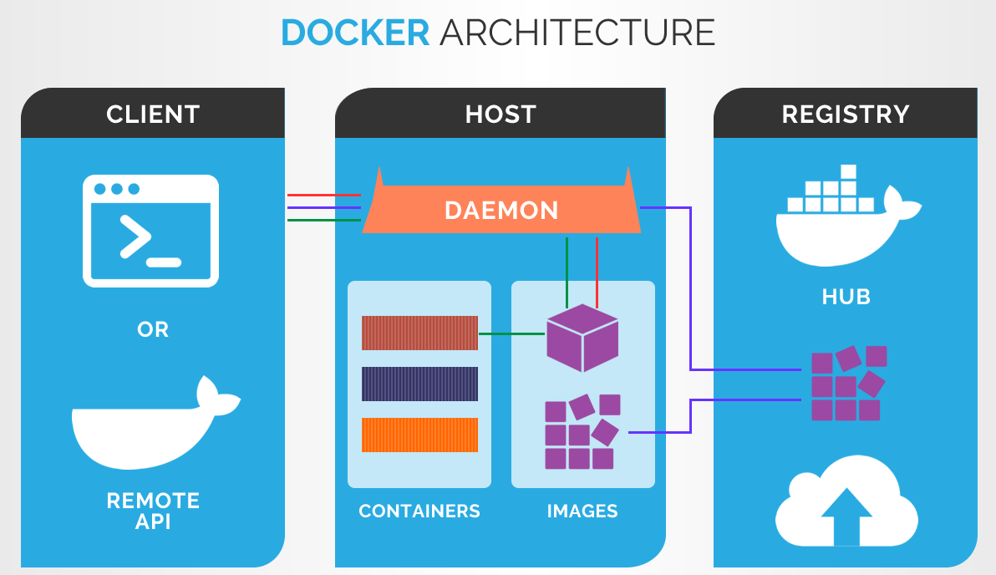
Docker core concepts - Quick introduction
Image
A Docker image is a read-only template that contains the instructions for creating a Docker container.
Container
A lightweight, standalone, and executable software package that includes everything needed to run an application - the code, runtime, system tools, libraries, and settings.
Isolate applications from their environment, ensuring that the application runs consistently across different computing environments (e.g., development, testing, and production).
Containerization
Containerization is the process of packaging an application and its dependencies into a standardized unit called a container.
Docker compose
Define and run multi-container applications.
Allows defining the services, networks, and volumes that make up an application in a single YAML file, making it easier to manage and deploy the application.

Slide 10
Docker core concepts - Quick introduction
Docker Networking
Docker provides built-in networking capabilities that allow containers to communicate with each other and with the host system.
Containers can be connected to one or more networks, and each network has its own IP address range and DNS resolution.
Docker Volumes
Docker volumes are used to persist data generated by a container.
Volumes are independent of the container's lifecycle and can be shared between containers.
Volumes provide a way to store and manage data outside of the container's file system, making it easier to backup, restore, and share data between different environments.
Volumes can be used to store application data, configuration files, and other persistent data that needs to be accessed by the container

Slide 11
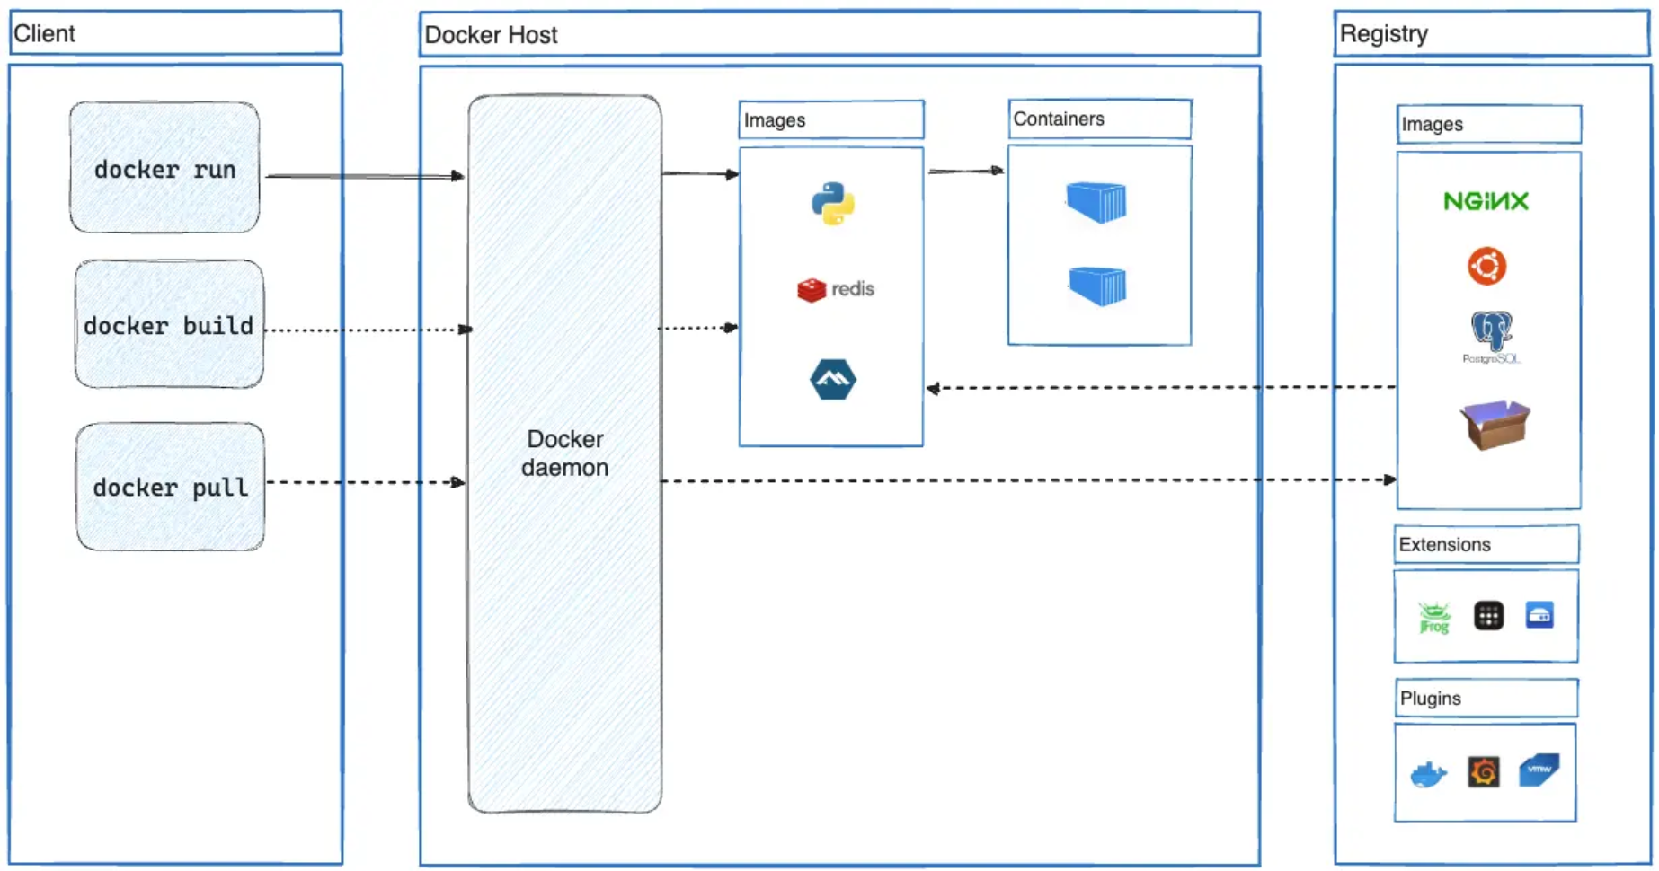
Docker – How it works?

Slide 12
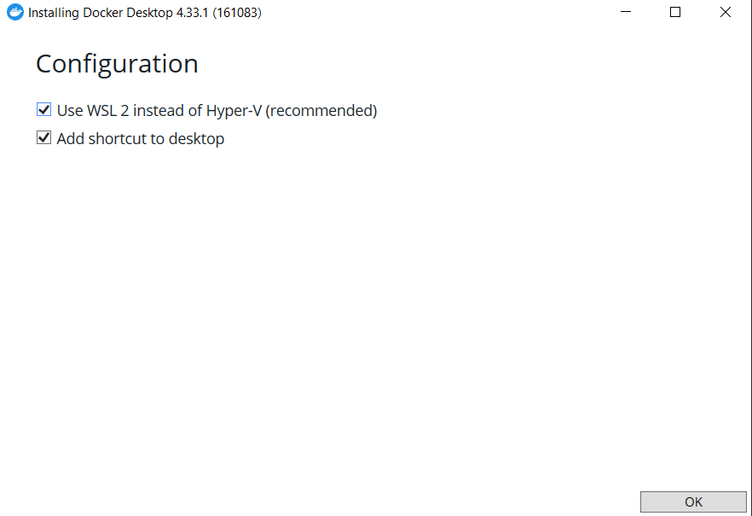
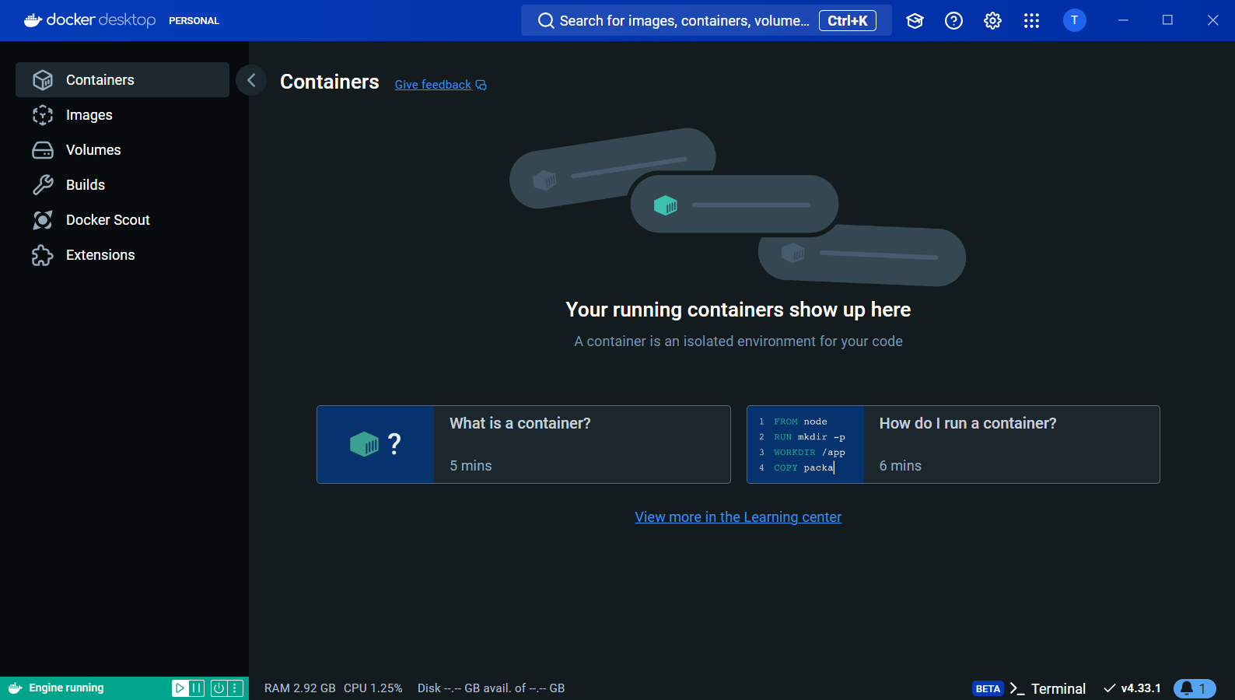
Setup Docker Desktop
Download and Install Docker Desktop

Slide 13
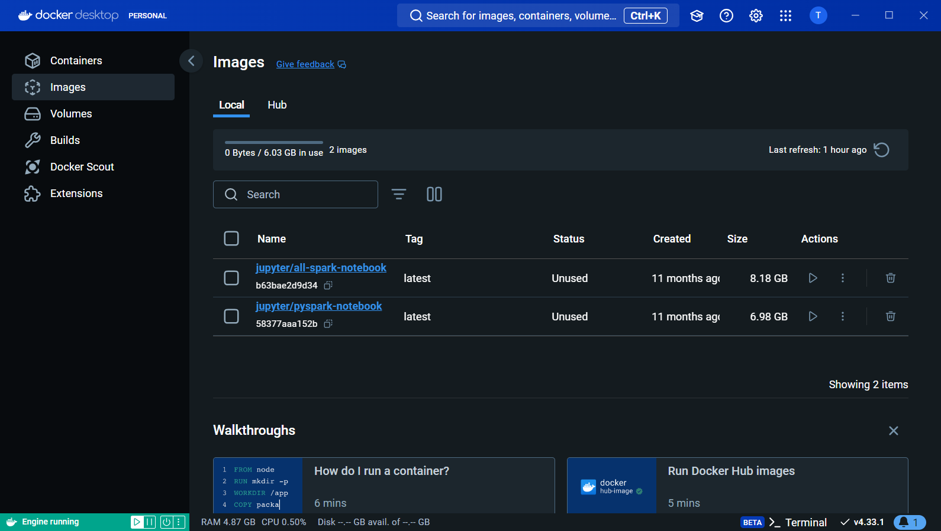
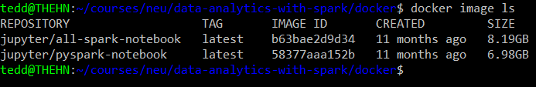
Launch Docker, Pull images
Complete Docker setup
Launch Docker Desktop to start Docker services
(For Windows) Open WSL terminal to activate Linux shell
Execute below command to pull docker image:
docker pull jupyter/pyspark-notebook
Verify the image pulled successfully
Using Docker Desktop UI
Using docker command from terminal docker image ls
References:
jupyter/docker-stacks: Ready-to-run Docker images containing Jupyter applications (github.com)
Selecting an Image — Docker Stacks documentation (jupyter-docker-stacks.readthedocs.io)

Slide 14
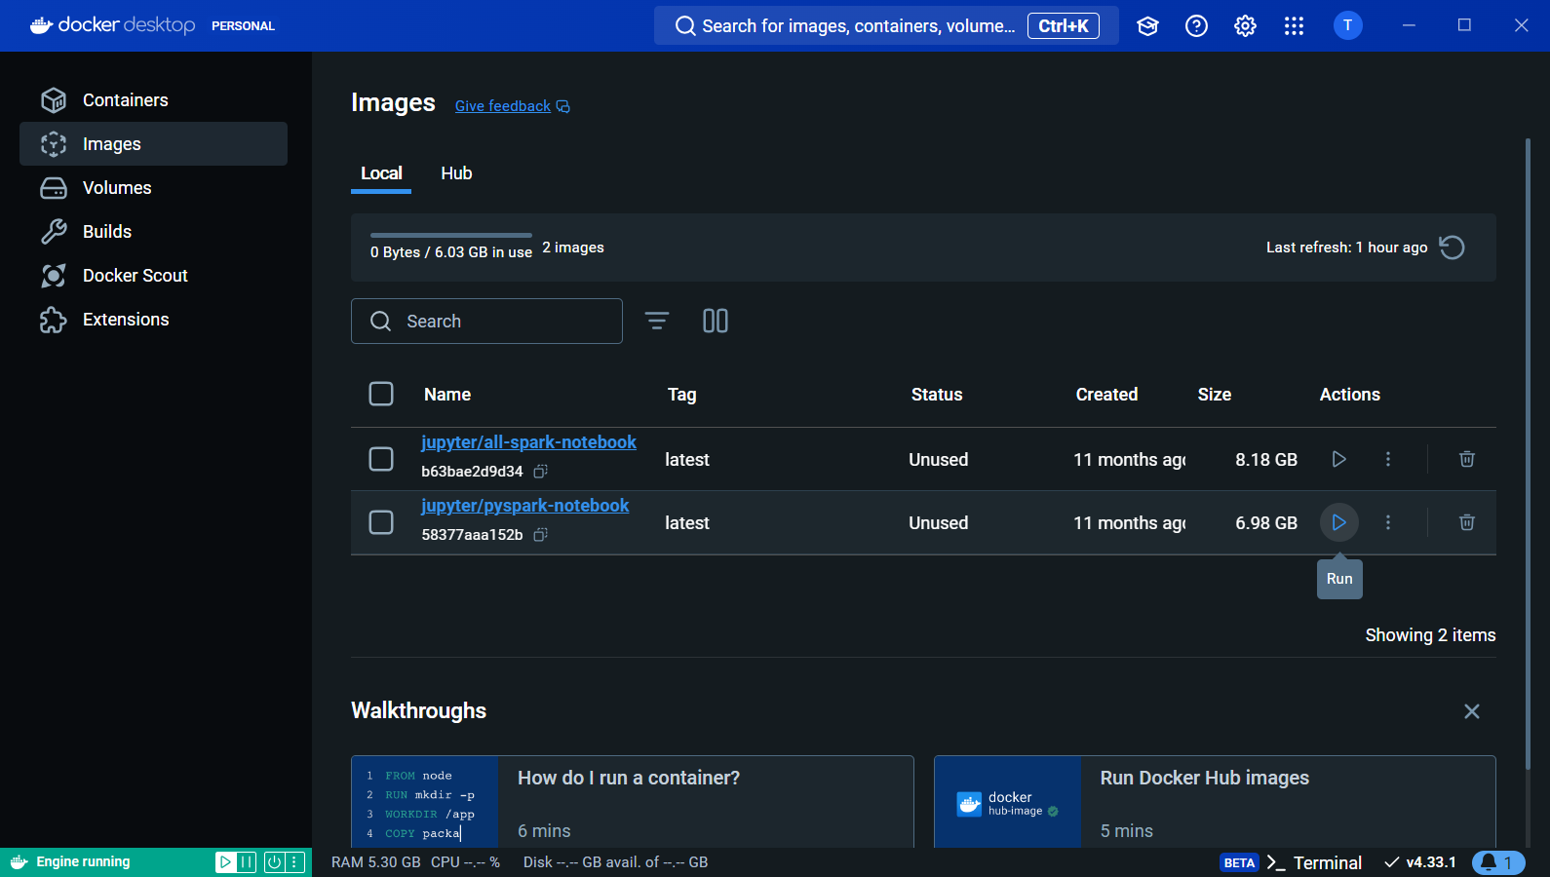
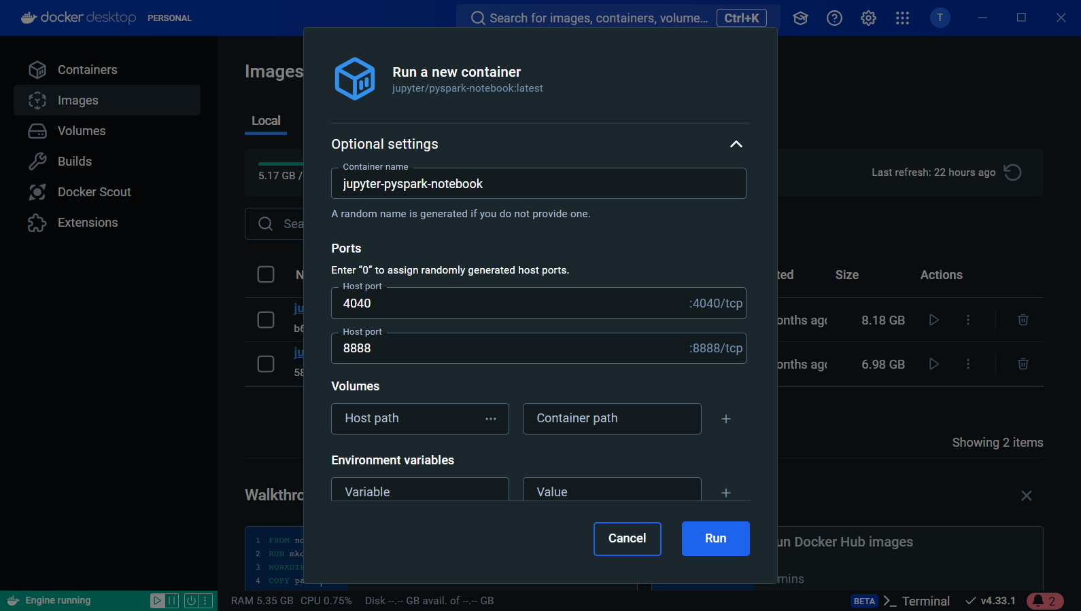
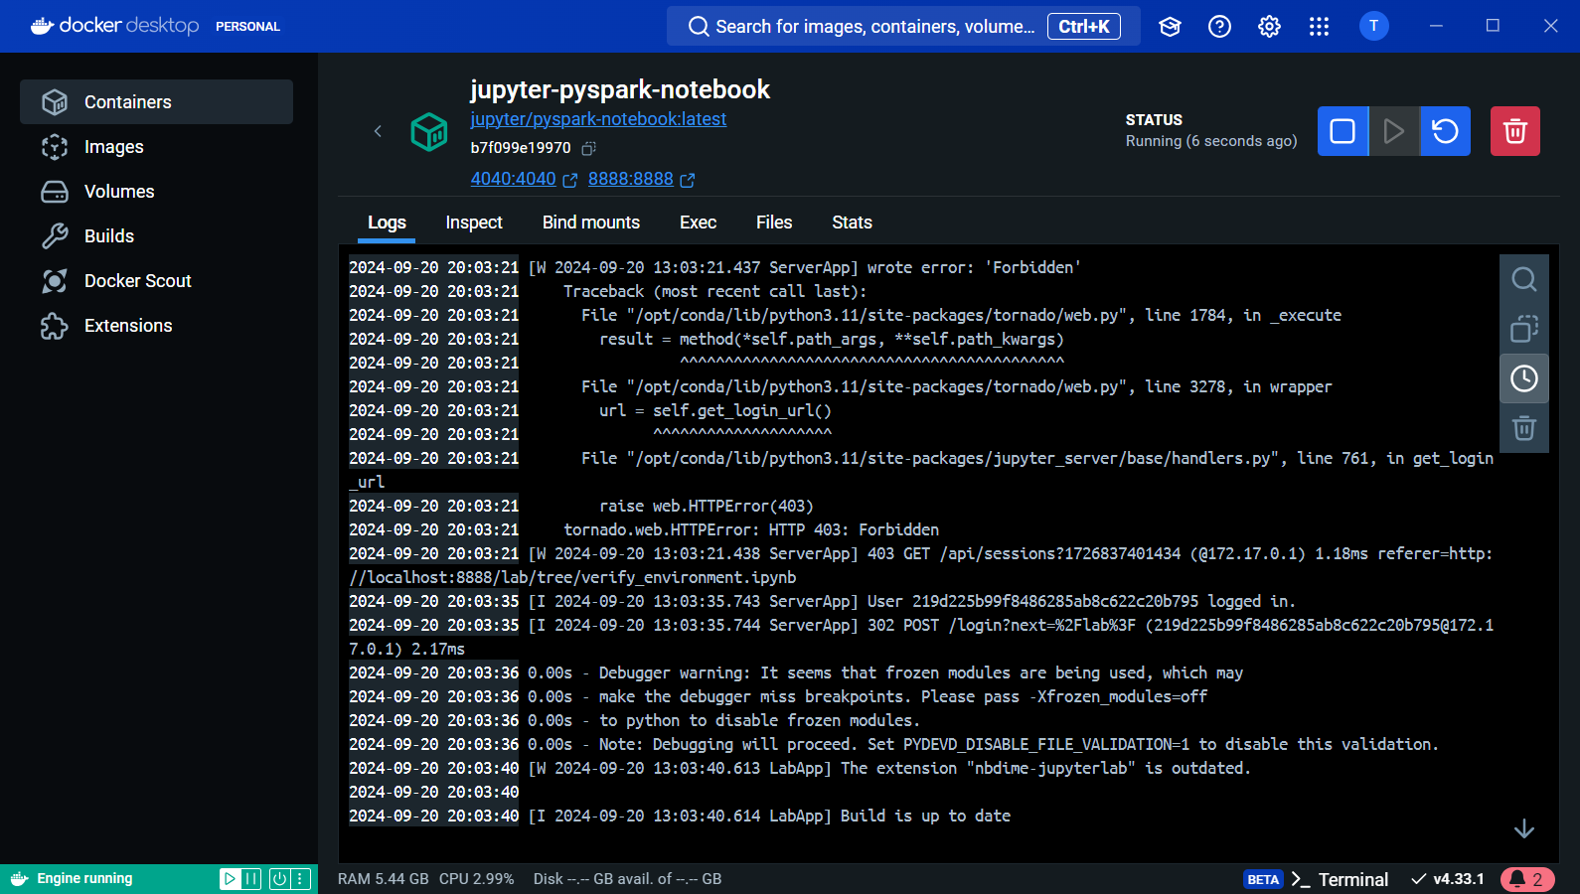
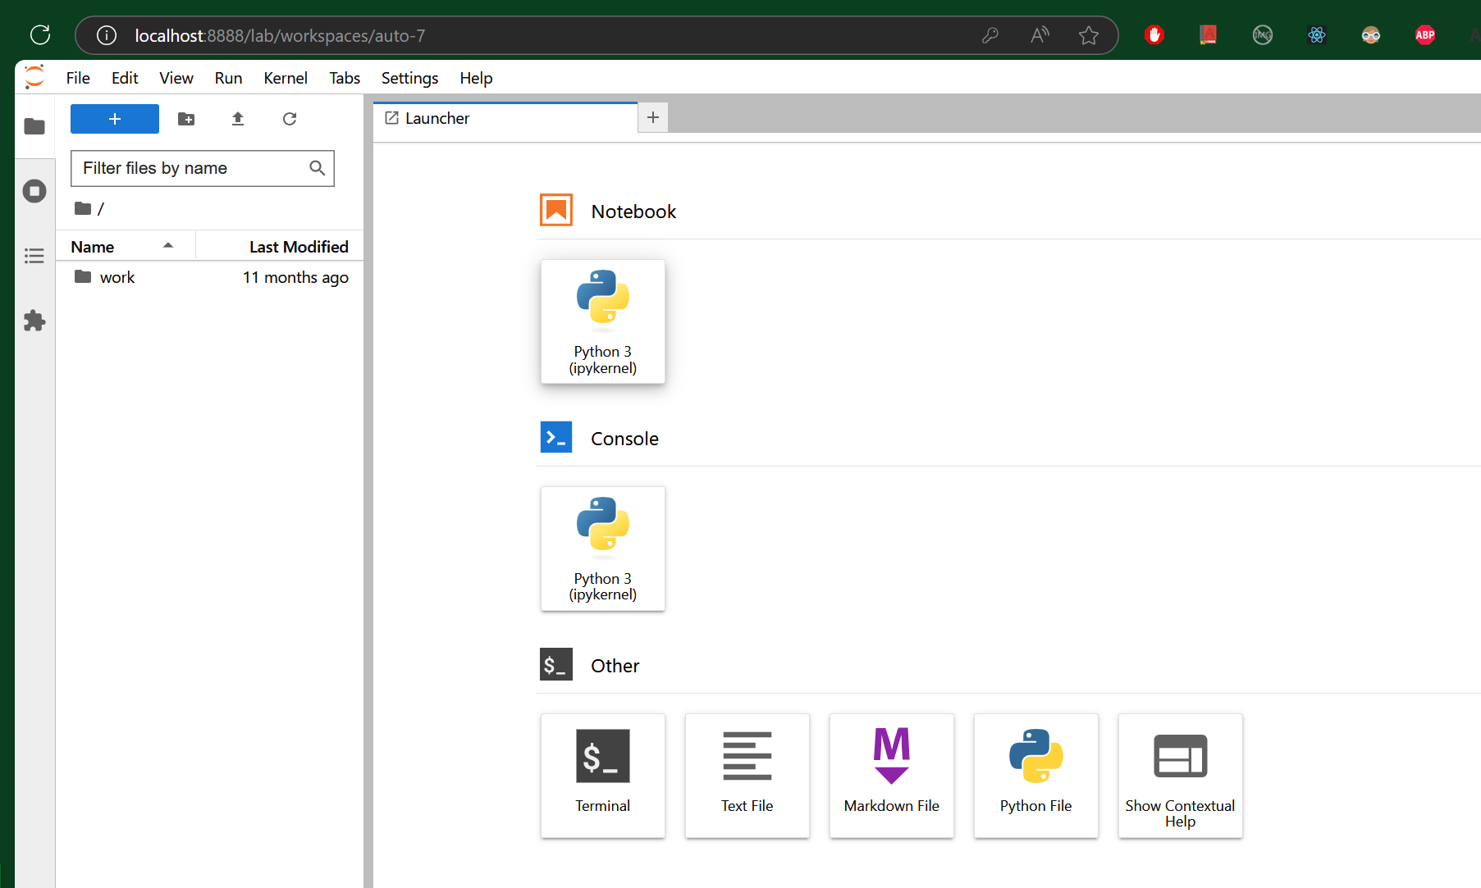
Run Docker Container
1
Execute from Docker desktop UI
2
3
4

Slide 15
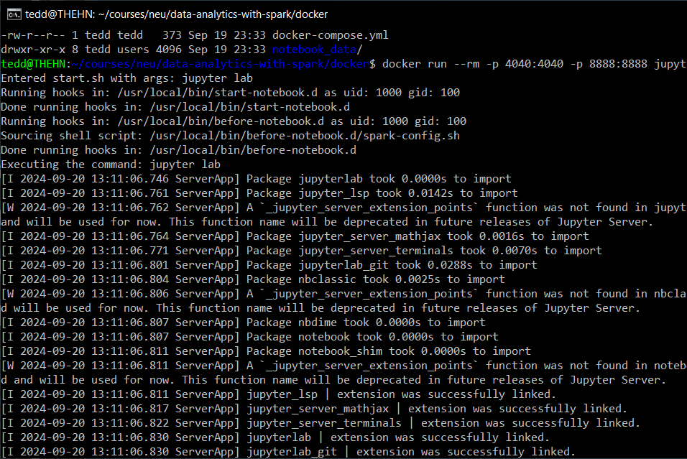
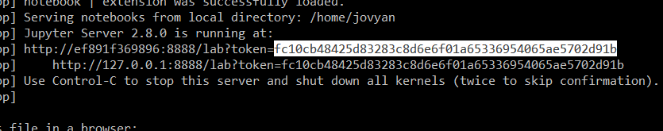
Run Docker Container
Execute from Terminal using Docker commands
docker run --rm -p 4040:4040 -p 8888:8888 jupyter/pyspark-notebook
Copy token from Terminal and use it for login

Slide 16
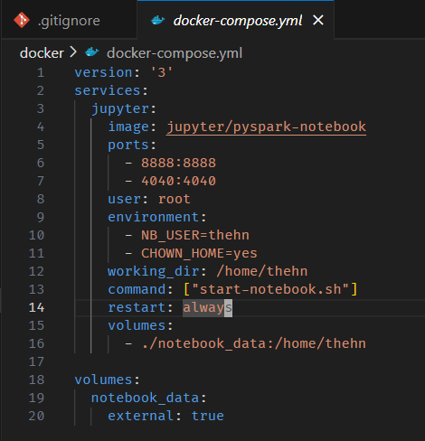
Run Docker Container
Create docker-compose application
File name: docker-compose.yml
Services
Image
Ports
User
Environment
Working Directory
Command
Restart
External Volumes

Slide 17
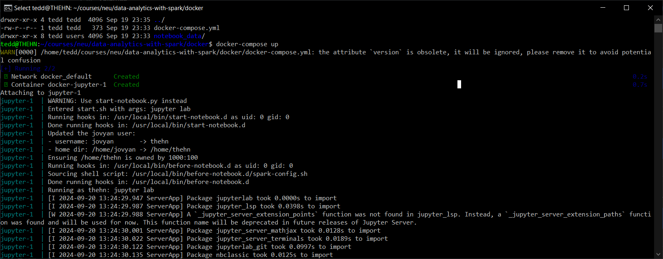
Run Docker Container
Execute docker-compose application
Navigate to directory which contains the docker-compose.yml
Execute: docker-compose up
Optional parameter: -d
Change password for the next logins

Slide 18
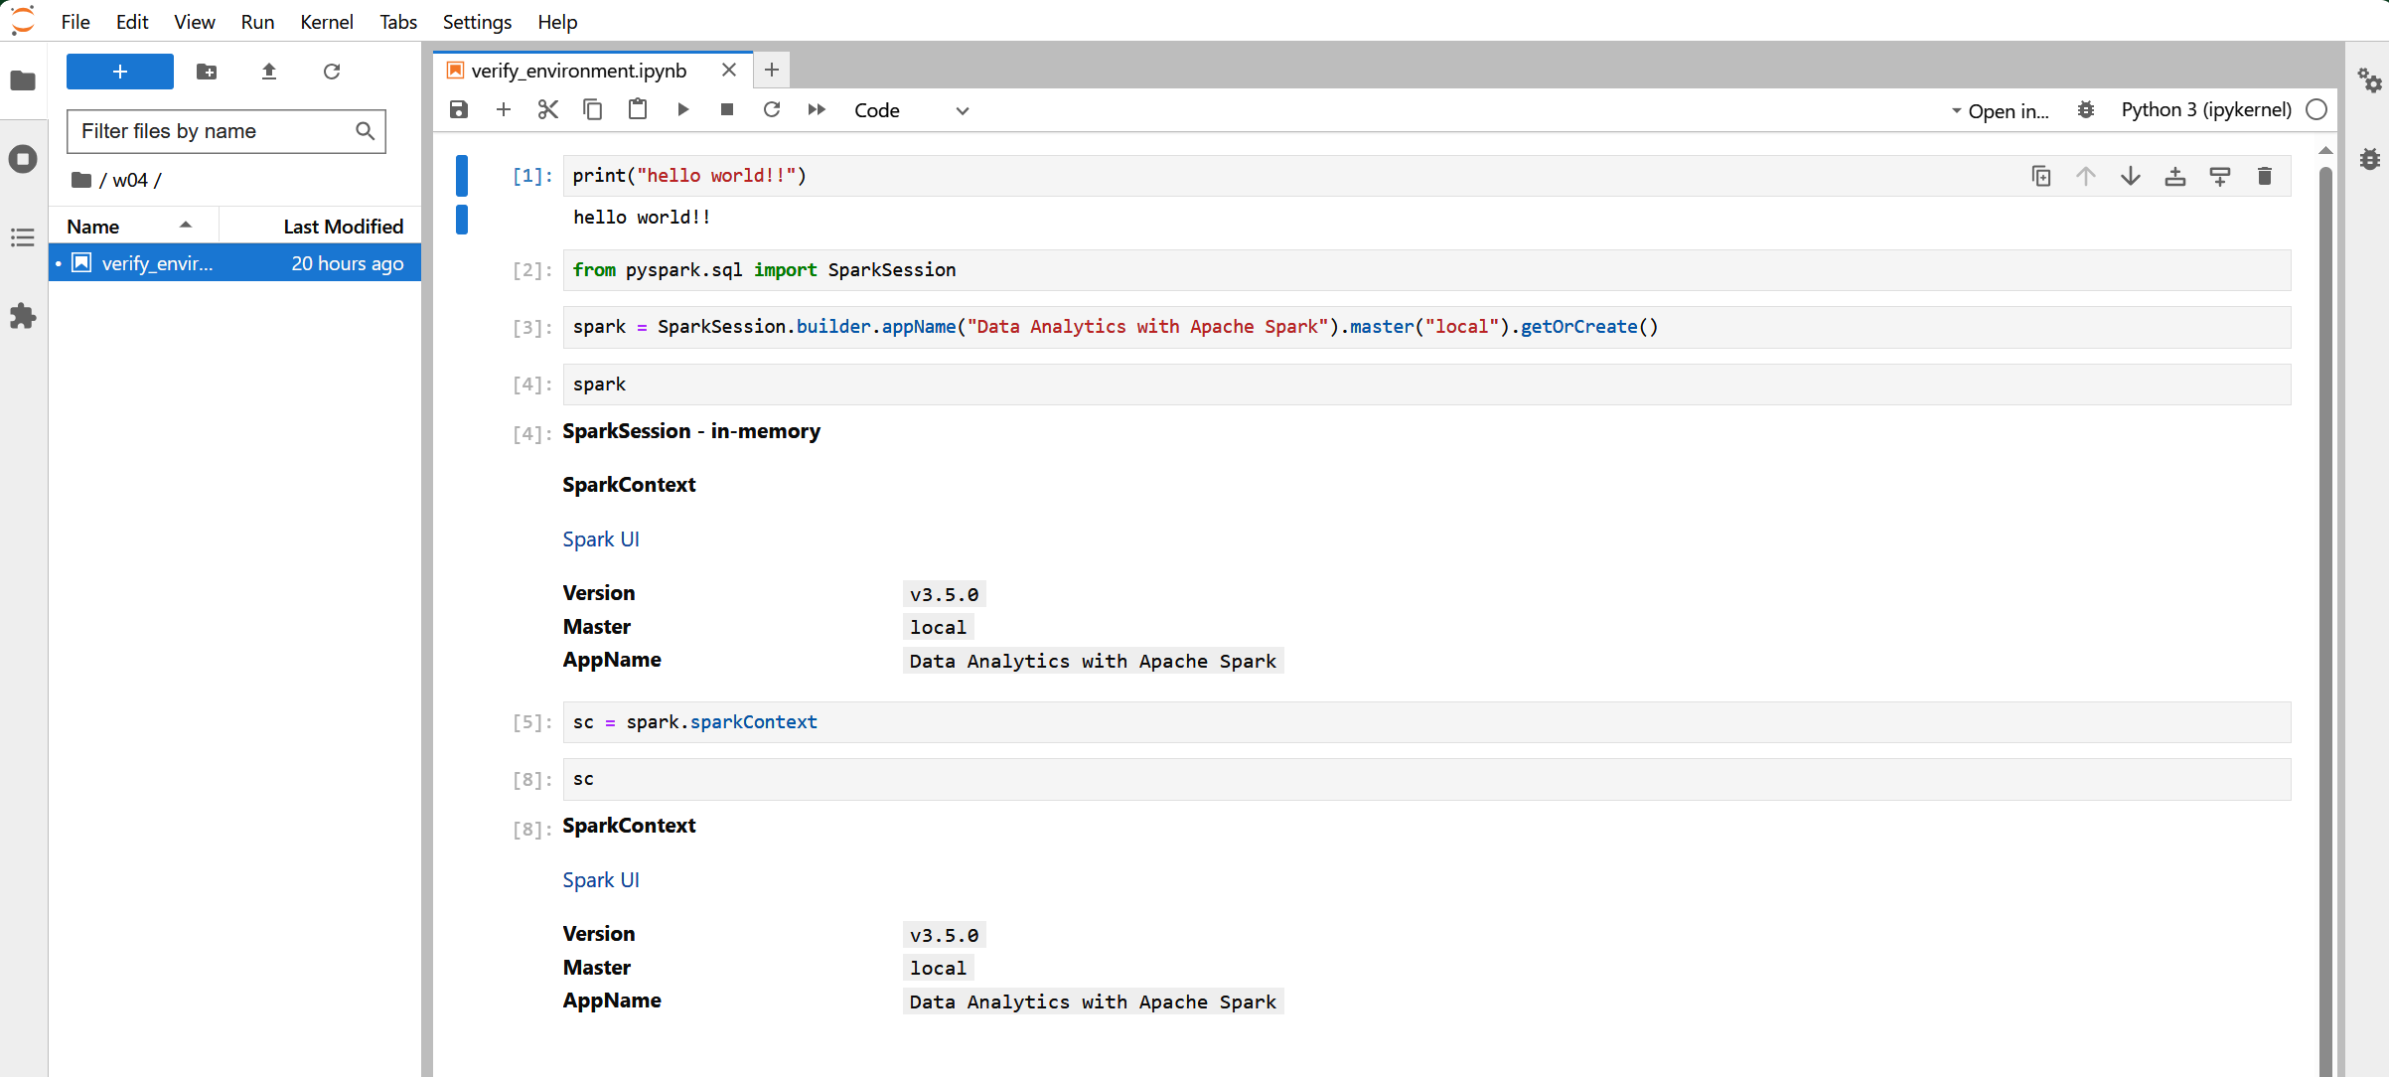
Jupyter Pyspark Notebook
Verify environment and setup

Slide 19
Lab 01: Introduction to SparkContext and RDDs
2024
The Hoang

Slide 20
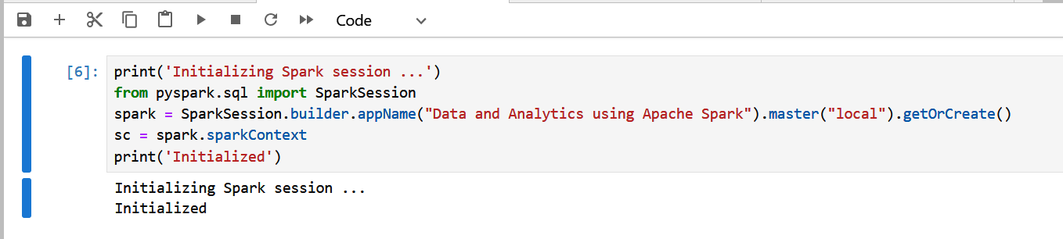
SparkSession and SparkContext
Initialize SparkSession
Get SparkContext from SparkSession

Slide 21
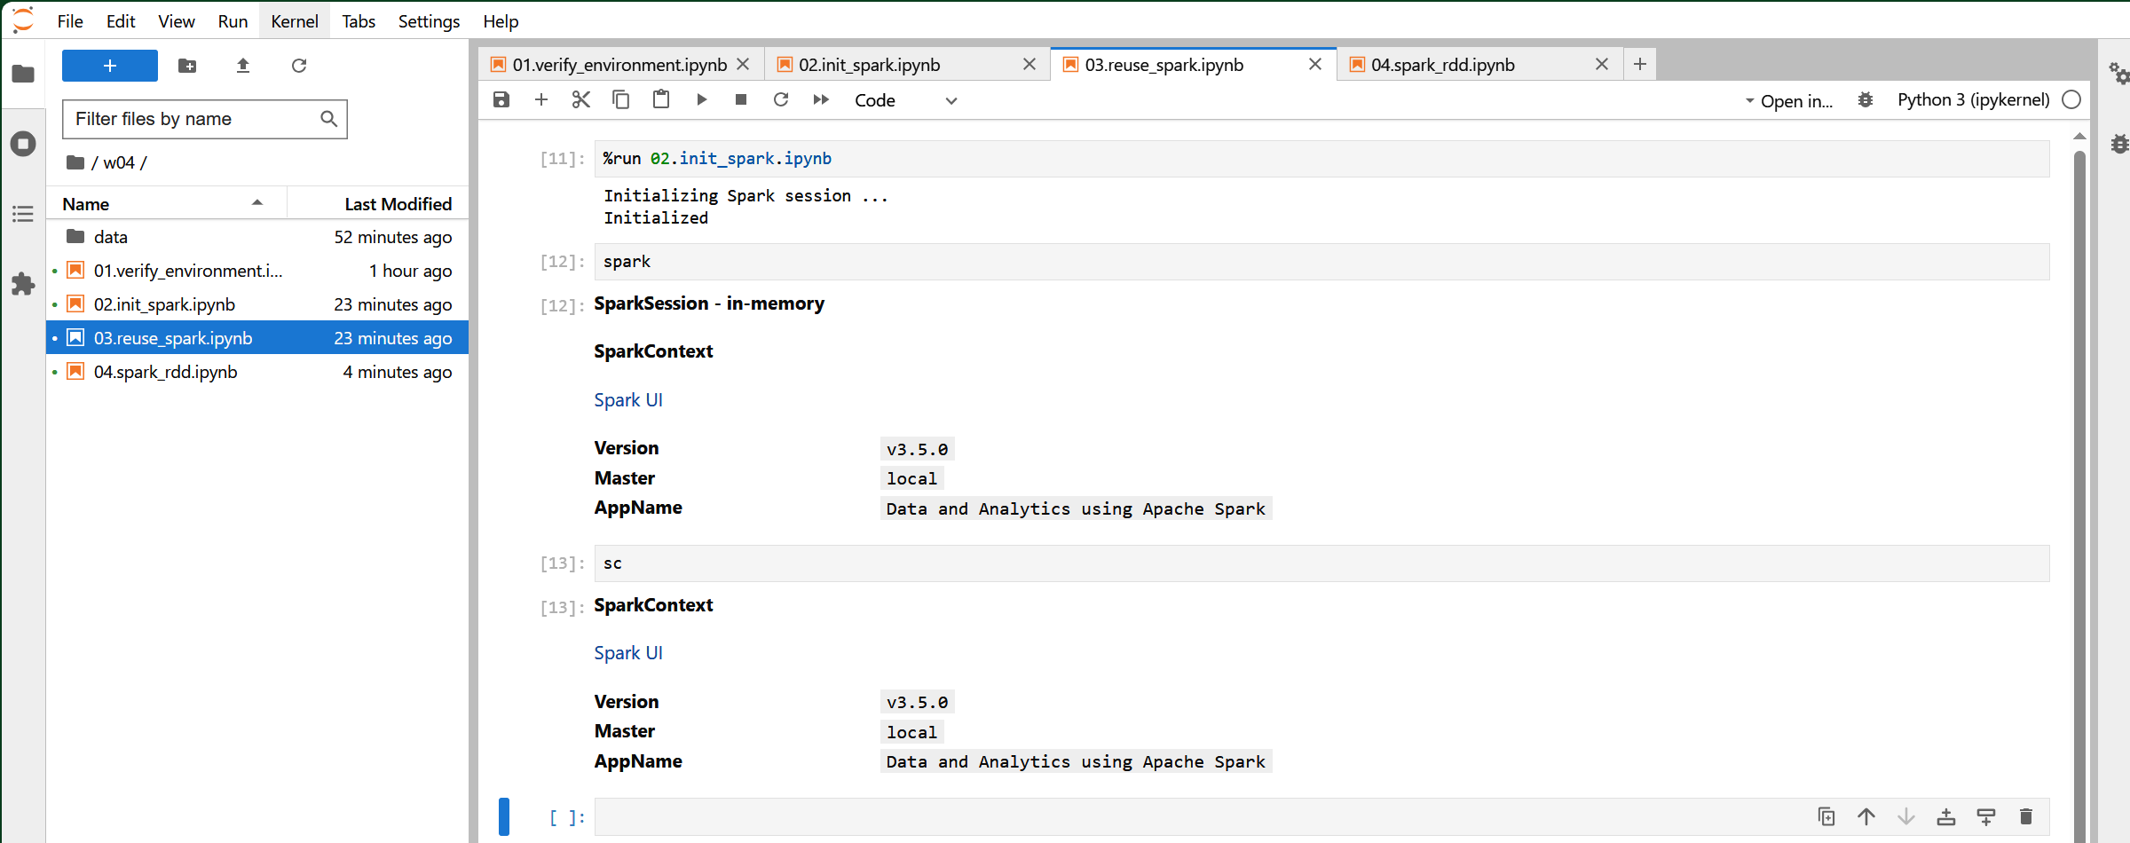
SparkSession and SparkContext
Make the initialization reusable

Slide 22
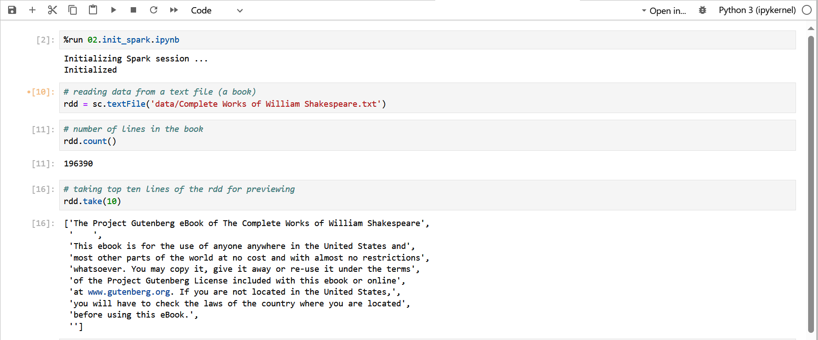
Spark RDD APIs – Creation
Creating RDD from a text file

Slide 23
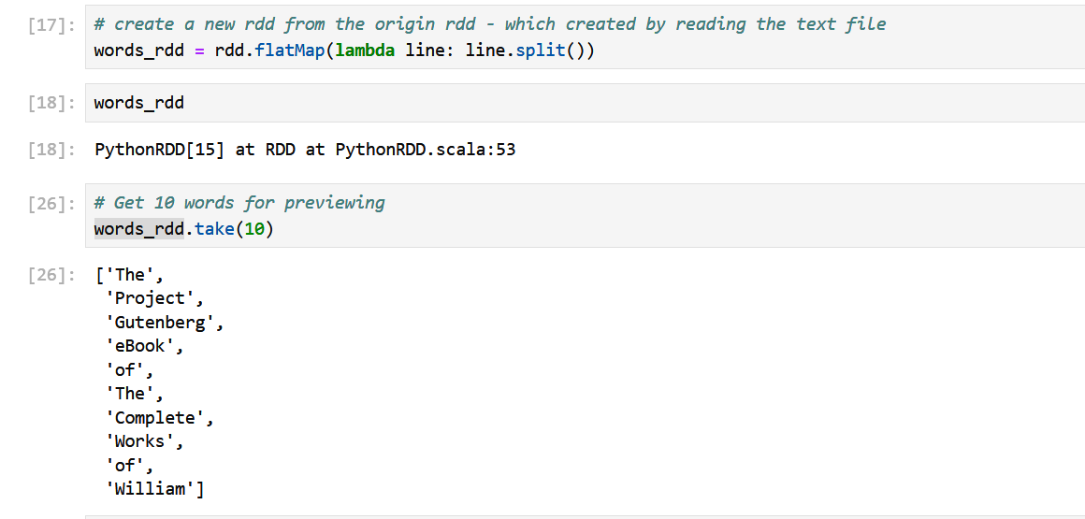
Spark RDD APIs – Creation
Creating a new RDD from an existing RDD

Slide 24
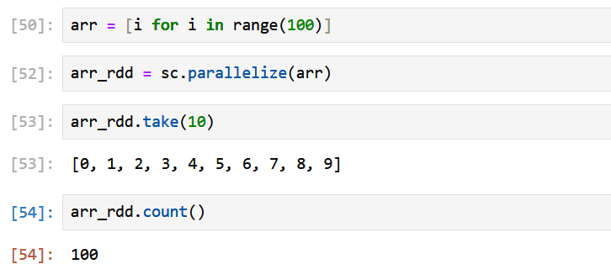
Spark RDD APIs – Creation
Creating from a sequence (list)

Slide 25
Spark RDD APIs – Transformations
Manipulate RDD transformation APIs to work with text data:
Narrow transformation: flatMap, map, filter

Slide 26
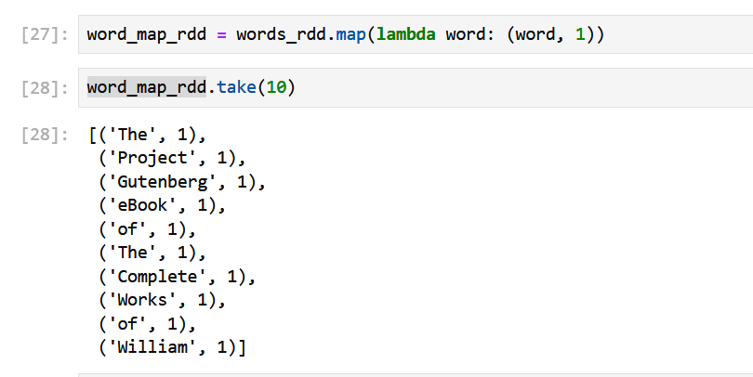
Spark RDD APIs – Transformations
Manipulate RDD transformation APIs to work with text data:
Narrow transformation: flatMap, map, filter

Slide 27
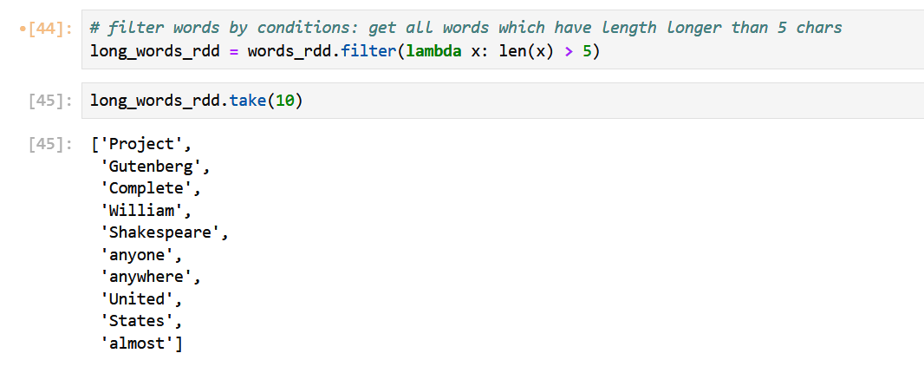
Spark RDD APIs – Transformations
Manipulate RDD transformation APIs to work with text data:
Narrow transformation: flatMap, map, filter

Slide 28
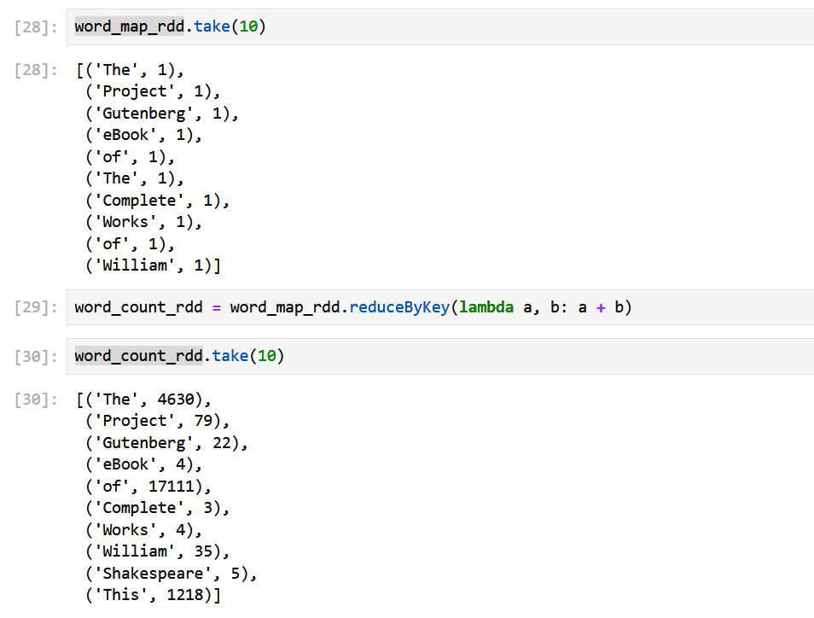
Spark RDD APIs – Transformations
Manipulate RDD transformation APIs to work with text data:
Wide transformation: reduceByKey, sortByKey

Slide 29
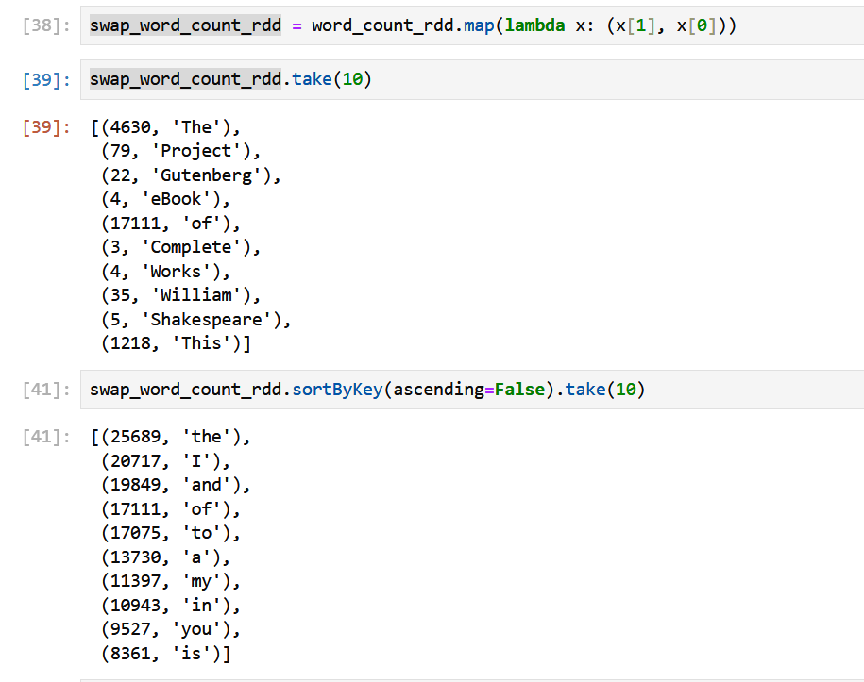
Spark RDD APIs – Transformations
Manipulate RDD transformation APIs to work with text data:
Wide transformation: reduceByKey, sortByKey

Slide 30
Spark RDD APIs – Transformations
Manipulate RDD transformation APIs to work with text data:
Wide transformation: reduceByKey, sortByKey

Slide 31
Spark RDD APIs – Actions
Manipulate RDD transformation APIs to work with text data:
rdd.collect(): Return all elements as an array in the driver program.
rdd.count(), rdd.countByValue(): Return the number of elements or count of each unique value.
rdd.take(n), rdd.takeSample(withReplacement, num, seed): Return the first n elements or a random sample.
rdd.reduce(func), rdd.fold(zeroValue)(func): Aggregate elements using a function.
rdd.saveAsTextFile(path), rdd.saveAsSequenceFile(path): Save the RDD to a file.

Slide 32
Spark RDD APIs – Persistence
Manipulate RDD transformation APIs to work with text data:
rdd.cache(), rdd.persist(storageLevel): Cache the RDD in memory or on disk for reuse.
rdd.checkpoint(): Mark the RDD for checkpointing to fault-tolerant storage.

Slide 33
Spark RDD APIs – Persistence
Feature | Checkpointing | Caching
Purpose | To save the state of RDDs/DataFrames to reliable storage for fault tolerance and lineage truncation. | To store intermediate data in memory for faster access during subsequent operations.
Storage | Writes data to a reliable storage system (e.g., HDFS, S3). | Keeps data in memory (RAM) for quick retrieval.
Data Materialization | Materializes the data and breaks the lineage, meaning subsequent operations don't need to recompute previous transformations. | Keeps data in memory but retains lineage, allowing Spark to recompute if needed.
Performance Impact | Involves I/O overhead since data is written to disk, which can slow down performance. | Provides faster access due to in-memory storage, significantly speeding up repeated queries.
Use Cases | Best for long-running applications, iterative algorithms, or when data might be lost due to failures. | Ideal for iterative algorithms or repeated queries where the same dataset is accessed multiple times.
Eviction | Checkpointed data remains until explicitly removed or until the application ends. | Cached data can be evicted based on memory pressure (i.e., if Spark needs memory for other tasks).

Slide 34
Spark RDD APIs – Summary
Category | APIs
Narrow Transformations | map(), flatMap(), filter(), mapPartitions(), mapPartitionsWithIndex(), sample(), union(), intersection(), cartesian(), zip()
Wide Transformations | reduceByKey(), groupByKey(), join(), cogroup(), subtractByKey(), sortByKey(), aggregateByKey(), foldByKey()
Actions | collect(), take(), count(), first(), reduce(), saveAsTextFile(), countByKey(), foreach()
Others | cache(), persist(), unpersist(), coalesce(), repartition(), glom(), getNumPartitions()

Slide 35
DataFrames APIs – Creation
From a physical data source:
File storage: CSV, JSON, Parquet, Delta Lake, HUDI, Iceberg …
Message Queue: Apache Kafka, …
From a sequence / list
From another DataFrames

Slide 36
DataFrames APIs – Narrow Transformations
.select()
.withColumn()
.filter()
.drop()
.distinct()
.limit()
.selectExpr()
.replace()
.fillna() or .na.fill()
.dropna()

Slide 37
DataFrames APIs – Wide Transformations
.groupBy()
.join()
.orderBy() or sort()
.coalesce()
.repartition()
.rollup()
.cube()
.dropDuplicates()

Slide 38
DataFrames APIs – Actions
.show()
.count()
.collect()
.first()
.head()
.take()
.describe()
.toPandas()
.write()

Slide 39
DataFrames APIs – Others
.explain()
.cache()
.persist()
.unpersist()
.printSchema()
.schema
.sample()
.corr() - Computes the correlation between two columns
.cov() - Computes the covariance between two columns
.approxQuantile() - Computes approximate quantiles
.crossJoin() - Performs a cartesian product of two DataFrames
createOrReplaceTempView() - Creates a temporary SQL view

Slide 40
DataFrames APIs – Summary
Category | APIs
Narrow Transformations | select(), withColumn(), filter(), drop(), distinct(), limit(), selectExpr(), replace(), fillna(), dropna(), na.fill()
Wide Transformations | groupBy(), agg(), join(), orderBy(), coalesce(), repartition(), rollup(), cube(), dropDuplicates()
Actions | show(), count(), collect(), first(), head(), take(), describe(), toPandas(), write()
Others | explain(), cache(), persist(), unpersist(), printSchema(), schema(), createOrReplaceTempView(), sample(), corr(), cov(), approxQuantile(), crossJoin()

Slide 41
Spark SQL – Data Definition Language (DDL)
createOrReplaceTempView(): Creates or replaces a temporary view using a DataFrame
createGlobalTempView(): Creates a global temporary view accessible across all sessions.
createGlobalTempView(): Creates a global temporary view accessible across all sessions.
dropGlobalTempView(): Removes a global temporary view.
sql(): Executes a SQL query.
createExternalTable(): Defines an external table using the data stored outside of Spark.

Slide 42
Spark SQL – Data Manipulation Language (DML)
insertInto(): Inserts the content of a DataFrame into an existing table.
df.write.mode(): Specifies the save mode when writing data (e.g., append, overwrite).
saveAsTable(): Saves the content of the DataFrame as a table.
drop(): Deletes a table or view.

Slide 43
Spark SQL – Query Execution and SQL Functions
Similar to Spark DataFrames APIs in the previous sections

Slide 44
Spark SQL – Catalog and Metadata Operations
listDatabases(): Lists all databases.
listTables(): Lists all tables in the current database.
listColumns(): Lists all columns of a specific table.
listFunctions(): Lists all available SQL functions.
currentDatabase(): Returns the current database name.
setCurrentDatabase(): Sets the current database.
isCached(): Checks if a table is cached.

Slide 45
Spark SQL – DataFrame to SQL Interoperability
table(): Loads a table as a DataFrame

Slide 46
Spark SQL – Summary
Category | APIs
Data Definition Language (DDL) | createOrReplaceTempView(), createGlobalTempView(), dropTempView(), dropGlobalTempView(), sql(), createExternalTable()
Data Manipulation Language (DML) | insertInto(), mode(), saveAsTable(), drop()
Query Execution and SQL Functions | select(), filter(), groupBy(), agg(), join(), orderBy(), explain(), show(), cache(), unpersist()
Catalog and Metadata Operations | listDatabases(), listTables(), listColumns(), listFunctions(), currentDatabase(), setCurrentDatabase(), isCached()
DataFrame to SQL Interoperability | table(), createDataFrame(), toPandas(), toJSON()
Caching and Persistence | cache(), persist(), unpersist()
Configuration and Optimization | explain(), describe(), corr(), approxQuantile()
I/O Operations (Read/Write) | read(), write(), parquet(), csv(), json(), jdbc()

Slide 47
Spark SQL – Online materials
Official document
Spark SQL Built-in Functions

Slide 48
References and Online Resources
Setup Pyspark environment – must be ready before tutorial sessions
Setup for Windows
Setup for MacOS (Linux)
Advanced: Setup Pyspark Notebook using Docker
Advanced: Setup a Spark cluster using Docker
Launch simple interactive Pyspark-shell
Starting point: Get SparkSession
Creating DataFrames
DataFrame Operations
Running SQL Queries
Global Temporary View
Interoperating with RDDs
Scalar Functions
Aggregate Functions
UDFs – User Defined Functions
UDAFs - User Defined Aggregation Functions
View & Understand SparkUI

Slide 49


Notes and Recommendations
Tools and Libraries:
Use Jupyter Notebook for all labs.
Make heavy use of the PySpark DataFrame API for customer analysis.
Datasets:
For datasets, you can explore freely available data on Kaggle and UCI Data Repository. These repositories contain numerous datasets related to customer analysis, e-commerce, and economics.
By completing these labs, you'll gain hands-on experience in using Apache Spark for customer analysis, which is highly valuable for economic research.

